Slide 1
Pragmatically Informative Text Generation
Sheng Shen, Daniel Fried, Jacob Andreas, and Dan Klein
Notes:
1. I'm Sheng Shen. Today I am going to present our recent work on how we'll model generation as a communicative game between speakers and listeners, and use that to make generation more contextual.

Slide 2
Why Might Generation Need Pragmatics?
Input, i
Name [Fitzbillies],
Type [Coffee Shop],
Food [English], Price [Cheap]
Speaker
Output, o
Fitzbillies is a cheap coffee shop.
Predicted Input, i
✗
Listener
Name [Fitzbillies],
Type [Coffee Shop],
Price [Cheap]
Notes:
First question, why might generation become a pragmatic problem?
Let us imagine a generation situation. We have a speaker, who wants to describe a restaurant with all the information from the input. Based on a current state-of-the-art seq2seq model. It indeed generate a fluent output, although it's missing English Food.]
This is actually a common issue for sequence to sequence models.. But we can fix this content dropping issue by using pragmatics, and modeling this as a communication game.
Just like in the real situation, we should have a listener to infer the conveyed information from the generated output.
In this case, we could see that for this output. Obviously, the listener can not infer the English food attribute back.
That’s the failure of this communicative game.
------------------------------
## But should we call this end of a communicative game from pragmatics perspective? The answer is no.
["how can we fix this?"- One solution, from pragmatics, is to model this as a communication game.]
[example task as running example, from structured MR. reading the example]
We'll focus on conditional generation tasks where we have some input, and want to convey all of the information that's in the input.
Let’s denote the model that takes these inputs and produces these outputs the "speaker”.
The examples we‘ll present for the first part of this talk will be from the End-to-end task, which has inputs that like attribute-key value pairs and outputs as the description of one restaurant.
However, A common issue of recent neural conditional generation systems is that, while their outputs are fluent, they're often underinformative: they fail to mention content in the input that they should.
We can see that issue even from the output of the sota seq2seq model. Fitzbillies is a cheap coffee shop. Yes, it is fluent and accurate. [The english food area turns out to be dropped in the output.]
But why pragmatics? Pragmatics is about modeling how speakers choose what to say in order to produce an effect in a listener. In our case, we'll create a listener whose task is to try to interpret the output of the speaker generation system, mapping it back to the space of meaning representations.
Here, for example, we could use a listener to tell that this is a bad output generated by the speaker, since it would be likely to produce a different interpretation than the input the speaker was shown.
------------
So in this case, "Fitzbillies is a cheap coffee shop." (with dropped English food) could not help us identify the original input.

Slide 3
Why Might Generation Need Pragmatics?
Input, i
Name [Fitzbillies],
Type [Coffee Shop],
Food [English], Price [Cheap]
Speaker
Output, o
Fitzbillies is a cheap English coffee shop.
Predicted Input, i
✔
Listener
Name [Fitzbillies],
Type [Coffee Shop],
Food[English], Price [Cheap]
Notes:
But when we change the output by a more informative one.
“Fitzbillies is a cheap English coffee shop.”
this is a good output, since it's the one that will allow the listener to correctly identify the input the speaker saw.
Okay, everything goes well and we call this a success of a communicative game.
So, how can we apply this: to model generation into a more general communicative game setting and make the speaker preserve the information. #make the information flow round-tripped.
--------------------------
First question, why might generation become a pragmatic problem?
We'll focus on conditional generation tasks where we have some input, and want to convey all of the information that's in the input.
Let’s denote the model that takes these inputs and produces these outputs the "speaker”.
The examples we‘ll present for the first part of this talk will be from the End-to-end task, which has inputs that like attribute-key value pairs and outputs as the description of one restaurant.
However, A common issue of recent neural conditional generation systems is that, while their outputs are fluent, they're often underinformative: they fail to mention content in the input that they should.
We can see that issue even from the output of the sota seq2seq model. Fitzbillies is a cheap coffee shop. Yes, it is fluent and accurate. [The english food area turns out to be dropped in the output.]
But why pragmatics? Pragmatics is about modeling how speakers choose what to say in order to produce an effect in a listener. In our case, we'll create a listener whose task is to try to interpret the output of the speaker generation system, mapping it back to the space of meaning representations.
Here, for example, we could use a listener to tell that this is a bad output generated by the speaker, since it would be likely to produce a different interpretation than the input the speaker was shown.
------------
So in this case, "Fitzbillies is a cheap coffee shop." (with dropped English food) could not help us identify the original input.

Slide 4
Generation as a Pragmatic Game
Input, i
Name [Fitzbillies],
Type [Coffee Shop],
Food [English], Price [Cheap]
Speaker
Output, o
Output, o
Fitzbillies is a cheap coffee shop.
Fitzbillies is a cheap English coffee shop.
✔
Predicted Input, i
Predicted Input, i
Predicted Input, i
Predicted Input, i
✗
✗
✗
Listener
Name [Fitzbillies],
Type [Coffee Shop],
Price [Cheap]
Name [Fitzbillies],
Price [Cheap]
Name [Fitzbillies],
Type [Coffee Shop],
Food [English], Price [Cheap]
Name [Fitzbillies],
Type [Coffee Shop],
Price [Cheap]
Notes:
Here is our modeling strategy.
Let’s consider the generation as [!!] a pragmatic game tree. So we have speaker layer and listener layer. The speaker is shown in input. Thus it will have a choice of outputs to produce..
After that, the listener is shown whatever output the speaker chooses, and makes a prediction about what input the speaker saw.
The communicative game will be successfull if [!!!] the speaker chooses an output that makes the listener likely to infer the right thing.
--------------------
We can model this process as a game tree, where the speaker is shown an input, and has a choice of outputs to produce.
Then, the listener is shown whatever output the speaker chooses, and makes a prediction about what input the listener saw.
predicted output does not match the original input
We need to make a choice for the speaker, given a model of what the listener will do. The objective for the speaker is to choose an output that makes the listener likely to do the right thing.
---------------
So let’s combine the two subtrees together to form a complete pragmatic game tree.
The information through the forward speaker and backward listener would be complete then.
But how exactly we model these two processes, let us step into more details.

Slide 5
Generation as a Pragmatic Game
Input, i
Name [Fitzbillies],
Type [Coffee Shop],
Food [English], Price [Cheap]
Speaker
Output, o
Output, o
Fitzbillies is a cheap coffee shop.
Fitzbillies is a cheap English coffee shop.
✔
Predicted Input, i
Predicted Input, i
Predicted Input, i
Predicted Input, i
✗
✗
✗
Listener
Name [Fitzbillies],
Type [Coffee Shop],
Price [Cheap]
Name [Fitzbillies],
Price [Cheap]
Name [Fitzbillies],
Type [Coffee Shop],
Food [English], Price [Cheap]
Name [Fitzbillies],
Type [Coffee Shop],
Price [Cheap]
Notes:
In this case, it will definitely be the speaker chooses to talk about “English coffee shop”. In response, the listener will infer the exact original information back.
--------------------
We can model this process as a game tree, where the speaker is shown an input, and has a choice of outputs to produce.
Then, the listener is shown whatever output the speaker chooses, and makes a prediction about what input the listener saw.
predicted output does not match the original input
We need to make a choice for the speaker, given a model of what the listener will do. The objective for the speaker is to choose an output that makes the listener likely to do the right thing.
---------------
So let’s combine the two subtrees together to form a complete pragmatic game tree.
The information through the forward speaker and backward listener would be complete then.
But how exactly we model these two processes, let us step into more details.

Slide 6
Generating Pragmatic Output Text
Input, i*
Name [Fitzbillies],
Type [Coffee Shop],
Food [English], Price [Cheap]
Speaker
Notes:
Let’s step into technical details about how should we build that pragmatic game tree.
Given input for the speaker, we need to model the conditional probability for outputs given input.

Slide 7
Generating Pragmatic Output Text
Input, i*
Name [Fitzbillies],
Type [Coffee Shop],
Food [English], Price [Cheap]
Speaker
Output, o
Output, o
Fitzbillies is a cheap English coffee shop.
Fitzbillies is a cheap coffee shop.
…
Notes:
Thus the speaker will have a choice of these candidate outputs.
We denote this stage as searching.

Slide 8
Generating Pragmatic Output Text
Input, i*
Name [Fitzbillies],
Type [Coffee Shop],
Food [English], Price [Cheap]
Searching:
Search over possible outputs o, using candidates from a standard seq-to-seq speaker model
Speaker
Output, o
Output, o
Output, o
Fitzbillies is a cheap English coffee shop.
Fitzbillies is a cheap coffee shop.
Fitzbillies is a cheap coffee shop.
…
Notes:
We denote this stage as searching,
Noted that there is a huge number of possible outputs that the speaker could produce;
To avoid the cost of considering all of them, we’ll rely on a existing sota model to just give us reasonable literal interpretations of the input.
Ok, this is for the speaker layer, now we will introduce the next layer of the game tree that could improve the speaker layer## and complete this pragmatic game.

Slide 9
Generating Pragmatic Output Text
Input, i*
Name [Fitzbillies],
Type [Coffee Shop],
Food [English], Price [Cheap]
Searching:
Search over possible outputs o, using candidates from a standard seq-to-seq speaker model
Speaker
Output, o
Output, o
Output, o
Fitzbillies is a cheap English coffee shop.
Fitzbillies is a cheap coffee shop.
Fitzbillies is a cheap coffee shop.
…
Predicted Input, i
Predicted Input, i
Listener
P(i |o)
Name [Fitzbillies],
Type [Coffee Shop],
Food [English], Price [Cheap]
Name [Fitzbillies],
Type [Coffee Shop],
Price [Cheap]
…
Notes:
The listener.
Given each output, to infer information back, the listener is supposed to model the conditional probability given output for predicted inputs.
Thus we ask the listener to score each predicted input for all possible outputs.
We denote this stage as scoring.

Slide 10
Generating Pragmatic Output Text
Input, i*
Name [Fitzbillies],
Type [Coffee Shop],
Food [English], Price [Cheap]
Searching:
Search over possible outputs o, using candidates from a standard seq-to-seq speaker model
Speaker
Output, o
Output, o
Output, o
Fitzbillies is a cheap English coffee shop.
Fitzbillies is a cheap coffee shop.
Fitzbillies is a cheap coffee shop.
…
Scoring:
Choose an output with maximum listener probability, P(i* | o)
Predicted Input, i
Predicted Input, i
Predicted Input, i
Listener
P(i |o)
Name [Fitzbillies],
Type [Coffee Shop],
Food [English], Price [Cheap]
Name [Fitzbillies],
Type [Coffee Shop],
Price [Cheap]
Name [Fitzbillies],
Type [Coffee Shop],
Price [Cheap]
…
Notes:
So, to avoid the nasty content dropping problem, we could choose an output with maximum listener probability to interpret the origin input.
Also in practice, we know the ensembling is powerful, so we can actually ensemble speaker output probability and listener interpretation probability together for scoring stage.
Okay, at this stage we can tell the scoring is important. But how can we do that? This questions will lead to different ways to model our listener.

Slide 11
How to Construct the Listener?
Reconstructor-Based
Train a separate Listener model to give a distribution over any possible inputs.
Distractor-Based
Construct a context-appropriate distractor input that Listener needs to distinguish the true input from.
or
o
o
Listener
P(i |o)
i*
i
i₁
~
i
i
…
True Input
Distractor
All Possible Inputs
Notes:
We propose two different approaches to model the listener. Remember, the listener’s job is to map output to inputs.
How should we define the listener's response space will lead to these two different methods.
if we say all inputs are relevant, we'll get a reconstructor-based model: it means we have to reconstruct the exact input among all possible inputs. So in practice, we need a separately-trained model.
if we say we only need to differentiate the origin input from one or multiple context-appropriate distractor input, it is much easier for us to directly compute that conditional probability for scoring.
[and use Bayesian inference over the true and distractor inputs with the Speaker model.]
Here, the key distinction is whether you're distinguishing among everything, or just something contextually relevant.
--------
## [So in practice, we train a separate Listener model to give a distribution over any possible inputs, And use this for scoring outputs produced by the Speaker model]
##with a reused speaker and Bayesian rules.
For the distractor-based model, we will construct a context-appropriate distractor input, and use Bayesian inference over the true and distractor inputs with the Speaker model.

Slide 12
Past Work on Pragmatic Generation
Convey All Relevant Info
[Grice 1970, Horn 1984, Dušek and Jurčíček 2016,
Li et al. 2016,
He et al. 2016, Fried et al. 2018, Cohn-Gordon et al. 2019, ...]
Be Informative in Context
[Golland et al. 2010, Frank and Goodman 2012, Mao et al. 2015, Andreas and Klein 2016, Vedantam et al. 2018, Cohn-Gordon et al. 2018, …]
Motivates Reconstructor
Motivates Distractor
Notes:
These two listeners are motivated by two lines of past work on pragmatics.
First is the pragmatic maxim of quantity: when people communicate, they aim to convey all relevant information well. This motivates our reconstructor-based technique.
Another focuses on producing language that is informative in context: picking out a particular reference from alternatives. This motivates the distractor-based technique:
[when describing a given input, we construct a contextually-relevant alternative, and say something that distinguishes the input from the alternative.]

Slide 13
Reconstructor-Based Pragmatics
o₁
Listener
P(i |o)
i₁
i
i
…
All Possible Inputs
Notes:
In the detail, for the reconstructor-based pragmatics, the listener will directly give the probability for each alternative input.

Slide 14
Reconstructor-Based Pragmatics
True input
i*
Speaker
P(o | i*)
Searching:
Obtain candidate outputs
by beam search in P(o | i*)
o₁
o₂
o₃
Listener
P(i |o)
i₁
i₁
i₁
i
i
i
i
i
i
…
…
…
All Possible Inputs
All Possible Inputs
All Possible Inputs
Notes:
In this way, we will start by obtaining candidate outputs. We'll do this by beam search in the speaker model, using the scores P(o | i) that it defines.

Slide 15
Reconstructor-Based Pragmatics
True input
i*
Speaker
P(o | i*)
Searching:
Obtain candidate outputs
by beam search in P(o | i*)
o₁
o₂
o₃
0.3
0.6
0.1
Listener
P(i |o)
i₁
i₁
i₁
Scoring:
Score and select o using P(i* | o)
i*
i
i
i₃
i
i
…
…
…
All Possible Inputs
All Possible Inputs
All Possible Inputs
Notes:
Then Based on the listener, we could get the conditional probability for each alternative input given candidate output.
Note that 0.3 corresponds to the probability for true input given output o1. [pause!]
To maximize this probability , we will select the argmax outputs o2 at the scoring stage.

Slide 16
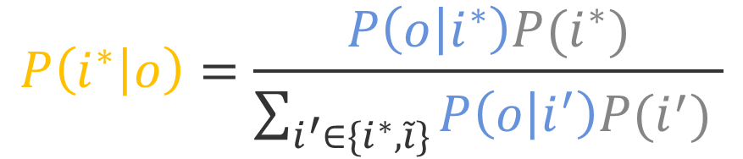
Distractor-Based Pragmatics
When we use a Listener can only produce the true input and a distractor, we can define the Listener using the Speaker and Bayes’ rule:
True input
Searching:
Obtain candidate outputs by beam search in P(o | i*)
i*
Speaker
P(o | i*)
Given by seq-to-seq Speaker
Use a uniform prior
o
$$P\left(i^{∗} | o\right)=\frac{P\left(o | i^{∗}\right)P(i^{∗})}{\sum_{i^{′}∈\{i^{∗}, \tilde{i}\}}{P\left(o | i^{′}\right)P(i^{′}) }}$$
Listener
P(i |o)
i*
i
~
Scoring:
Choose output by argmax_{o} P(i* | o)
True Input
Distractor
Notes:
for our distractor-based listener, it only needs to distinguish between the true input and a distractor, so we don't need a separate listener model for this simpler listener response space. Instead, we can reuse the speaker, and Bayes rule.
In the search stage, we first obtain candidate outputs by beam search, we then plug in the prior distribution for all alternative inputs. Let’s assume they are uniform for simplicity.
In the scoring stage, we choose the output by the argmax of P(I* | o). [In practice, we could also employ more than one distractor to encourage information more discriminative.]
[pause!] => [reconstructor stuff] => whether we have a separate listener model or just a reused speaker for scoring stage.
===================
On the other side for distractor-based pragmatics. the listener only needs to distinguish between the true input and a distractor.
Remember what we need to model here is the probability given each output for two alternative inputs, so we do not need a separately-trained model. In this case, since the listener's response space is simpler, we can just reuse the speaker model, and Bayes' rule.
the Bayesian inference over the true and distractor inputs will be a combination of forward probability from speaker and the prior distribution, which signifies how likely the output comes from each alternative input.

Slide 17
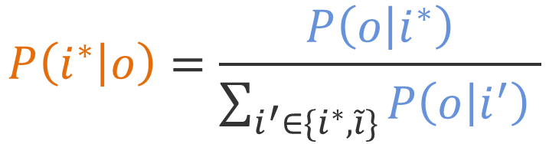
Distractor-Based Pragmatics
Possible Outputs
(search over these)
$$P\left(i^{∗} | o\right)=\frac{P\left(o | i^{∗}\right)}{\sum_{i^{′}∈\{i^{∗}, \tilde{i}\}}{P\left(o | i^{′}\right) }}$$
o₁
o₂
Fitzbillies is a cheap coffee shop.
Fitzbillies is a cheap English coffee shop.
…
True Input, i*
Name [Fitzbillies],
Eat Type [Coffee Shop], Food[English], Price[Cheap]
…
0.4
0.2
Inputs
~
Distractor,
i
Name [Fitzbillies],
Eat Type [Coffee Shop], Price[Cheap]
…
0.8
0.05
Notes:
Then I will run through an example to show how should our distractor-based pragmatic method work.
First stage, we only have true input. The generation step is as usual. The speaker generate possible outputs and search over these based on probability P(o | i*) . These blue scores from speaker. [sadly, if we only used the speaker scores, we'd choose o1 at this stage][ since neural model may prefer short output in our preliminary test=?]
The 0.4 looks good but Is that enough? We can see that xxx may not be discriminative enough when we plug in xxx. Or we should ask, is “Fitzbillies is a cheap coffee shop.” discriminative enough?
Probably no, so we plug in one context-appropriate distractor input (without English food in this case).
Well, we could see the o1 is also good for this distractor. So it may not be the least ambiguous one. How to choose that one out is something we care?
----------------------------
the speaker generates the probability for each candidate output from both true input and distractor input. You can see the scores. They stand for the probability the speaker assigns them.

Slide 18
Distractor-Based Pragmatics
Possible Outputs
(search over these)
$$P\left(i^{∗} | o\right)=\frac{P\left(o | i^{∗}\right)}{\sum_{i^{′}∈\{i^{∗}, \tilde{i}\}}{P\left(o | i^{′}\right) }}$$
o₁
o₂
Fitzbillies is a cheap coffee shop.
Fitzbillies is a cheap English coffee shop.
…
True Input, i*
Name [Fitzbillies],
Eat Type [Coffee Shop], Food[English], Price[Cheap]
…
0.33
0.8
Inputs
~
Distractor,
i
Name [Fitzbillies],
Eat Type [Coffee Shop], Price[Cheap]
…
0.66
0.2
Notes:
So we bring in Bayesian inference with normalization for each output across alternative inputs.
[In this case, The o2 with English food is an obvious choice.]
Because we can see that this output o2 helps the listener to differentiate the true input from the alternative input the most.
That’s also the reason why the distractor-based pragmatics helps.

Slide 19
Distractor-Based Pragmatics
Possible Outputs
(search over these)
$$P\left(i^{∗} | o\right)=\frac{P\left(o | i^{∗}\right)}{\sum_{i^{′}∈\{i^{∗}, \tilde{i}\}}{P\left(o | i^{′}\right) }}$$
o₁
o₂
Fitzbillies is a cheap coffee shop.
Fitzbillies is a cheap English coffee shop.
…
True Input, i*
Name [Fitzbillies],
Eat Type [Coffee Shop], Food[English], Price[Cheap]
…
0.33
0.8
Inputs
~
Choose argmax o as the pragmatic output!
Distractor,
i
Name [Fitzbillies],
Eat Type [Coffee Shop], Price[Cheap]
…
0.66
0.2
In practice: do the search and normalization incrementally, word-by-word. [Cohn-Gordon et al. 2018.]
Notes:
it will finally lead us to do the argmax and choose the most informative output.
[pause!] In practice, we do the search and normalization incrementally, word-by-word.

Slide 20
Generation from Meaning Representations
Input:
Output:
Name[Fitzbillies],
EatType[Coffee Shop],
PriceRange[Cheap],
Area[Riverside],
Food[English]
Seq-to-Seq Speaker
O
lexicalization
Fitzbillies is a coffee shop that serves English food.
It is located in riverside area.
[Puzikov and Gurevych, 2018]
Notes:
It is more broader in our tasks.
[Tasks look like before pragmatics.]
The E2E generation task is just like the examples we've seen so far, but with a bit more complex inputs and outputs.
The current state-of-the-art speaker model is based on one seq2seq model with lexicalization.
Then how should we construct our listener model?

Slide 21
Generation from Meaning Representations
Reconstructor:
S^{R} (a multi-task classifier) maps each output to input.
Input:
Classifier
Name[Fitzbillies],
EatType[Coffee Shop],
PriceRange[Cheap],
Area[Riverside],
Food[English]
Classifier
o
Fitzbillies is a coffee shop that serves English food.
It is located in riverside area.
Classifier
Classifier
Classifier
i₁
i
Listener
P(i* |o)
i
…
All Possible Inputs
Notes:
How we construct the reconstructor-based pragmatics.
The reconstructor-based listener models the probability given o for each input.
Here the input is just multiple attribute-key pairs. Then for each pair from origin input (like Fizniliies as name, coffee shop as type or cheap price), we do a classification to see whether we can infer that pair from the output and combines the score together for the scoring stage. [pause]
[pause!]

Slide 22
Generation from Meaning Representations
Distractor:
S^{D} is based on the MR that masks out other attributes.
Input:
Name[Fitzbillies],
EatType[Coffee Shop],
PriceRange[Cheap],
Area[Riverside],
Food[English]
Eg: Near[Burger King]
o
Listener
P(i* |o)
i*
i
~
True Input
Distractor
Notes:
The distractor-based listener models only need the constructed context-appropriate distractor and speaker.
So to encourage the model to convey all the information from input, we construct the distractor MR with masking out all the other attributes.
This Near[Burger King] is not present in the origin input, makes it context-appropriate if we truly want to preserve all the attributes from true input.

Slide 23
Generation from Meaning Representations
State-of-the-Art
Base Speaker
Pragmatic with Reconstructor
Pragmatic with Distractor
[Puzikov and Gurevych, 2018]
Notes:
our base speaker obtains state-of-the-art on a range of metrics; we'll focus on BLEU as a representative.
It is straightforwad that recon-based pragmatics directly helps the information perservation and helps the base model with the inprovement of 2 points in BLEU.
Compared to the reconstructor-based method, the distractor-based method also helps, but not quite as much.
we assume the reason is the masking-out strategy for distractor may cause underlying correlations between atributes, which may hurt the performance a little bit.
=========
Other metics indicate the consistente finding we have in our paper.
that reconstructor-based is more straightforward for information perservation.

Slide 24
Abstractive Summarization
Long Document:
Extracted Sentences:
Abstractive Output:
Final Output:
1. Manchester City became the latest team to be eliminated from Europe;
2. City were dumped out of the Champions League last 16 by Barcelona.
3. …
It is the primary reason all four
English teams - Liverpool , Chelsea , Arsenal and Manchester City - were eliminated from the Champions League before the quarter-final draw.
…
I_{e1}
O_{a1}
Extractor
o
o
I_{e2}
O_{a2}
o
Seq-to-Seq Speaker
o
I_{e3}
O_{a3}
o
o
[Chen and Bansal, 2018]
Notes:
The Abstractive Summarization task is a little complex as we need to generate summarization for one long document.
The state-of-the-art model from [Chen & Bansal] involves two stages. One extractor to extract candidate sentences from the documents and one seq2seq model to abstractive the extracted sentences.
We only introduce pragmatics method for the abstractive stage.
The same question, how should we construct our listener model?

Slide 25

Abstractive Summarization
Long Document:
Extracted Sentences:
Seq-to-Seq Listener
Abstractive Output:
Reconstructor:
S^{R} (seq-to-seq model) maps abstractive outputs to extractive inputs.
I_{e1}
O_{a1}
Extractor
o
o
I_{e2}
O_{a2}
o
o
I_{e3}
O_{a3}
o
o
Seq-to-Seq Speaker
Notes:
The reconstructor-based listener models the probability given o for each input.
It is straightforward that we uses a separate reconstuctor that maps each abstractive outputs to extractive inputs.

Slide 26
Abstractive Summarization
Long Document:
Extracted Sentences:
Abstractive Output:
Distractor:
For a given extracted sentence, use the next extracted sentence as the distractor.
I_{e1}
O_{a1}
Extractor
o
Listener’s Distractor
o
I_{e2}
O_{a2}
o
Listener’s Distractor
o
I_{e3}
O_{a3}
o
o
Seq-to-Seq Speaker
Notes:
The distractor-based listener model only needs the construted context-appropriate distractor and speaker.
So what the context-appropriate distractor here should be?
The repetitiveness is always a problem in summarization. Thus for a given extracted sentence, we use the next extracted sentence as the distractor.
Because we do not want the information from the previous extracted sentence to show up in the following summarization.

Slide 27
Abstractive Summarization
State-of- the-Art
Base Speaker
Pragmatic Rec.
Pragmatic Distr.
State-of- the-Art
Base Speaker
Pragmatic Rec.
Pragmatic Distr.
[Celikylimaz+ ‘18]
[Chen & Bansal ‘18]
[Paulus+ ‘18]
[Chen & Bansal ‘18]
Notes:
More numbers in the y-axis
[Chen & Bansal] is strong enough across metrics, although more recent system has improved the performance on each metric separately.
You can see that our reconstructor-based model turns out to have fair improvement over the base model.
Not like E2E tasks, the distractor-based method achieves better performance.
The phenomenon is also reasonable since it helps to mitigate the repetitiveness issues in summarization.
[We are presenting these two representative metrics, other metrics indicate consistent findings in our paper.]

Slide 28
Conclusions
Modeling generation as a speaker-listener game leads to more adequate and informative outputs
Computational pragmatics produces improvements for general text generation tasks
i
o
o
i
i
i
i
i
i
Notes:
Briefly summarize our finding as following.
Modeling generation as a pragmatic game leads to more adequate and informative outputs.
Computational pragmatics can benefit general text generation tasks.

Slide 29
Thanks!
Our code is publicly available at
https://github.com/sIncerass/prag_generation

Slide 30
Generation from Meaning Representations
State-of-the-Art
Base Speaker
[Puzikov and Gurevych, 2018]

Slide 31
Generation from Meaning Representations
State-of-the-Art
Base Speaker
Pragmatic with Reconstructor
[Puzikov and Gurevych, 2018]

Slide 32
Abstractive Summarization
State-of- the-Art
Base Speaker
State-of- the-Art
Base Speaker
[Celikylimaz+ ‘18]
[Chen & Bansal ‘18]
[Paulus+, ‘18]
[Chen & Bansal, ‘18]
Notes:
[Chen & Bansal] is strong enough across metrics, although more recent system has improved the performance on each metric separately.
We are presenting these two representative metrics, other metrics indicate consistent findings in our paper.

Slide 33
Abstractive Summarization
State-of- the-Art
Base Speaker
Pragmatic Rec.
State-of- the-Art
Base Speaker
Pragmatic Rec.
[Celikylimaz+ ‘18]
[Chen & Bansal ‘18]
[Paulus+ ‘18]
[Chen & Bansal ‘18]
Notes:
You can see that our recontructor-based model turns out to have fair improvement over the base model.

Slide 34
Why Might Generation Need Pragmatics?
Input, i
Name [Fitzbillies],
Type [Coffee Shop],
Food [English], Price [Cheap]
Speaker
Output, o
Fitzbillies is a cheap coffee shop.
Predicted Input, i
Listener
✗
Name [Fitzbillies],
Type [Coffee Shop],
Price [Cheap]
Notes:
First question, why might generation become a pragmatic problem?
Let us imagine a generation situation. We have a speaker, who wants to describe a restaurant with all the information from the input. Based on a current state-of-the-art seq2seq model. It indeed generate a fluent output, although it's missing English Food.]
But should we call this end of a communicative game from pragmatics perspective?
The answer is no. Just like in the real situation, we should have a listener to infer the conveyed information from the generated output.
In this case, we could see that for this output. Obviously, the listener can not infer the English food attribute back.
That’s the failure of this communicative game.
------------------------------
["how can we fix this?"- One solution, from pragmatics, is to model this as a communication game.]
[example task as running example, from structured MR. reading the example]
We'll focus on conditional generation tasks where we have some input, and want to convey all of the information that's in the input.
Let’s denote the model that takes these inputs and produces these outputs the "speaker”.
The examples we‘ll present for the first part of this talk will be from the End-to-end task, which has inputs that like attribute-key value pairs and outputs as the description of one restaurant.
However, A common issue of recent neural conditional generation systems is that, while their outputs are fluent, they're often underinformative: they fail to mention content in the input that they should.
We can see that issue even from the output of the sota seq2seq model. Fitzbillies is a cheap coffee shop. Yes, it is fluent and accurate. [The english food area turns out to be dropped in the output.]
But why pragmatics? Pragmatics is about modeling how speakers choose what to say in order to produce an effect in a listener. In our case, we'll create a listener whose task is to try to interpret the output of the speaker generation system, mapping it back to the space of meaning representations.
Here, for example, we could use a listener to tell that this is a bad output generated by the speaker, since it would be likely to produce a different interpretation than the input the speaker was shown.
------------
So in this case, "Fitzbillies is a cheap coffee shop." (with dropped English food) could not help us identify the original input.

Slide 35


Past Work on Pragmatic Generation
Pragmatic for Informativity Preservation
Grice 1970, Horn 1984, Golland et al. 2010, Frank and Goodman 2012; Monroe et al. 2018
Pragmatic for contextual discrimination
Andreas and Klein 2016, Vedantam et al. 2018, Cohn-Gordon et al. 2018
“Two children are playing”
“The sun is in the sky”
Input:
✔
✔
✗
Distractor:
✔
Notes:
Past work on pragmatics has characterized the language produced by people, observing wthether it’s informative-enough in context.
A long line of work models speakers as agents that reason about the listeners they interact with, so that the generated sentences should be specific enough that the listener can get the right interpretation.
For example like application in discriminative captioning, where a model has an input image that it needs to describe, and a distractor image that it needs to differentiate from.
So in this case, rather than producing the output of “Two children”, which is right for both images, but less descriptive. It should refer to “The sun is in the sky” that is only in the true input image
like choosing to refer to the “sun” rather than ”two children” which is only in the true input image (and not the distractor).
Our work is to show that (same approach can still help in a more general setting such as generation from meaning representations, and summarization.)

Slide 36
Experiments
Tasks
Pragmatic Methods
Generation from meaning representations
[E2E Dataset, Novikova et al. 2017]
Abstractive summarization
[CNN/Daily Mail; Hermann et al. 2015, Nallapati et al. 2017]
(S^{R}) Reconstructor-Based
(S^{D}) Distractor-Based
x
Notes:
we've introduced two pragmatic methods, reconstructor-based and distractor-based, which use a listener to make the commucaitve game complete).
We'll next evaluate this on two tasks... to see if it can improve strong state-of-the-art models" (or something)

Slide 37
(S^{D}) Distractor-based Examples
Previous Output:
Fitzbillies is a ______
Coffee
Current:
English
…
Inputs:
Name [Fitzbillies], Eat Type [Coffee Shop], Food [English], Price Range [Cheap].
Distractor:
Name [Fitzbillies], Eat Type [Coffee Shop], Price Range [Cheap].
0.5
0.3
…
0.6
0.1
…
[Puzikov and Gurevych, 2018]
Notes:
Normalization here is good!
Coffee+shop bigram issues. I still think we should do entire utterances, present word-level (and priors) as implementation details.
Distractor’s changed.

Slide 38
(S^{D}) Distractor-based Examples
Previous Output:
Fitzbillies is a ______
Coffee
Current:
English
…
Inputs:
Name [Fitzbillies], Eat Type [Coffee Shop], Food [English], Price Range [Cheap].
Distractor:
Name [Fitzbillies], Eat Type [Coffee Shop], Price Range [Cheap].
0.5/1.1
0.3/0.4
…
0.6/1.1
0.1/0.4
…
[Puzikov and Gurevych, 2018]
Notes:
Normalization here is good!
Coffee+shop bigram issues. I still think we should do entire utterances, present word-level (and priors) as implementation details.
Distractor’s changed.

Slide 39
(S^{D}) Distractor-based Examples
Previous Output:
Fitzbillies is a ______
Coffee
Current:
English
…
Inputs:
Name [Fitzbillies], Eat Type [Coffee Shop], Food [English], Price Range [Cheap].
Distractor:
Name [Fitzbillies], Eat Type [Coffee Shop], Price Range [Cheap].
0.46
0.75
…
0.54
0.25
…
[Puzikov and Gurevych, 2018]
Notes:
Normalization here is good!
Coffee+shop bigram issues. I still think we should do entire utterances, present word-level (and priors) as implementation details.
Distractor’s changed.

Slide 40
(S^{D}) Distractor-based Examples
Previous Output:
Fitzbillies is a ______
Coffee
Current:
English
…
Inputs:
Name [Fitzbillies], Eat Type [Coffee Shop], Food [English], Price Range [Cheap].
Distractor:
Name [Fitzbillies], Eat Type [Coffee Shop], Price Range [Cheap].
0.46
0.75
…
0.54
0.25
…
[Puzikov and Gurevych, 2018]
Notes:
Normalization here is good!
Coffee+shop bigram issues. I still think we should do entire utterances, present word-level (and priors) as implementation details.
Distractor’s changed.

Slide 41
(S^{D}) Distractor-based Examples
Previous Output:
Fitzbillies is a English ___
Coffee
English
Current:
…
Inputs:
Name [Fitzbillies], Eat Type [Coffee Shop], Food [English], Price Range [Cheap].
Distractor:
Name [Fitzbillies], Eat Type [Coffee Shop], Price Range [Cheap].
0.38
0.62
…
0.68
0.32
…
[Puzikov and Gurevych, 2018]
Notes:
We are using the single model (we can make the decision each time step for a single word.)

Slide 42
Analysis

Slide 43
Generation from Meaning Representations
Distractor:
S^{D} is based on the MR that masked out other attributes.
Eg: Near [Berkeley].
Input:
Name[Fitzbillies],
EatType[Coffee Shop],
PriceRange[Cheap],
CustomerRating[5 out of 5],
Area[Riverside],
FamilyFriendly[Yes]
Near[None]
Listener P(i | o)
Notes:
Strong baseline model => they can still be improved. (neural generation model.)

Slide 44
Pragmatic Effects on Informativity
Notes:
Explain more about. it. (look how often => simple heuristic based method.)

Slide 45
Abstractive Summarization
[Celikyilmaz et al., 2018]; [Paulus et al., 2018]; [Chen and Bansal, 2018]
Notes:
You can see that our model turns out to have reasonal improvement over the base model and achieves state-of-the-art results on METEOR metrics.

Slide 46
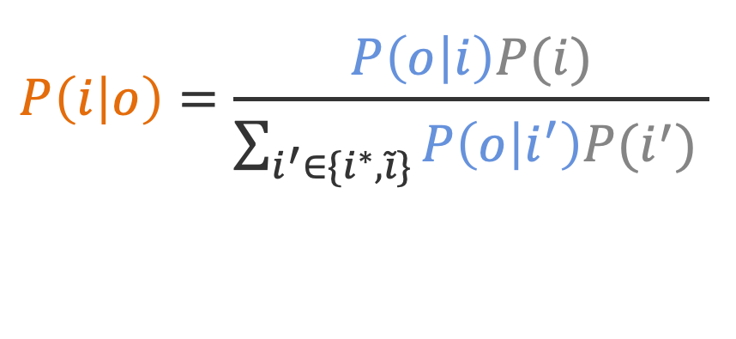
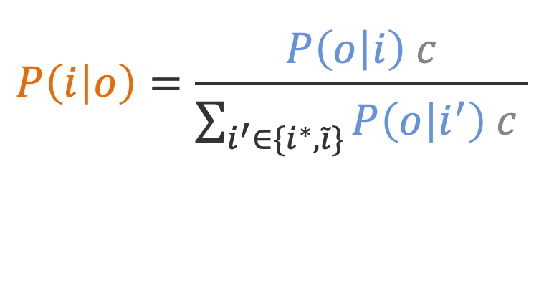
Distractor-Based Pragmatics
True input
i*
Given by seq-to-seq Speaker
Start with a uniform prior
Speaker P(o | i)
$$P\left(i | o\right)=\frac{P\left(o | i\right)P(i)}{\sum_{i^{′}∈\{i^{∗}, \tilde{i}\}}{P\left(o | i^{′}\right)P(i^{′}) }}$$
o
Listener P(i | o)
$$P\left(i | o\right)=\frac{P\left(o | i\right) c}{\sum_{i^{′}∈\{i^{∗}, \tilde{i}\}}{P\left(o | i^{′}\right) c }}$$
i*
i
~
True Input
Distractor
Notes:
On the other side for distractor-based pragmatics, we plug in the specific context-appropriate distractor input, the Bayesian inference over the true and distractor inputs will be a combination of forward probability from speaker and the prior distribution, which signifies how likely the output comes from each alternative input.

Slide 47
Why Might Generation Need Pragmatics?
Input, i
Name [Fitzbillies],
Type [Coffee Shop],
Food [English], Price [Cheap]
Speaker
Output, o
Fitzbillies is a cheap English coffee shop.
Listener
Predicted Input, i
Name [Fitzbillies],
Type [Coffee Shop],
Food [English], Price [Cheap]
✔
Notes:
However, an output with complete input could let the listener do that.
Our contribution in this work will be showing how very strong speaker models from psat work can be further improved by adding a listener, and using this sort of explicit pragmatic reasoning procedure.

Slide 48
Pragmatics for Abstractive Summarization
Abstractive Summarization
Long Document:
Extractive Output:
Distractor:
S^{D} is based on other followed extractive
sentence within the document.
Eg: Ex1 will be Ex2’s distractor.
The 1-0 scoreline that took Barcelona through to the Champions League quarterfinals made their clash with Manchester City all seem rather academic.
In truth, the English champions deserved little over the two legs as Barcelona built upon their 2-1 victory in Manchester three weeks ago to go through as 3-1 aggregate winners.
[Chen and Bansal, 2018]

Slide 49
Generation as a Pragmatic Game
Input, i
Name [Fitzbillies],
Type [Coffee Shop],
Food [English], Price [Cheap]
Speaker P(o | i)
Output, o
Output, o
Fitzbillies is a cheap coffee shop.
Fitzbillies is a cheap English coffee shop.
Listener P(i | o)
Predicted Input, i
Predicted Input, i
Predicted Input, i
Predicted Input, i
Name [Fitzbillies],
Type [Coffee Shop],
Price [Cheap]
Name [Fitzbillies],
Type [Coffee Shop],
Food [English], Price [Cheap]
Name [Fitzbillies],
Type [Coffee Shop],
Food [English], Price [Cheap]
Name [Fitzbillies],
Type [Coffee Shop],
Price [Cheap]
✗
✗
✔
✔
Notes:
We can model this process as a game tree, where the speaker is shown an input, and has a choice of outputs to produce.
Then, the listener is shown whatever output the speaker chooses, and makes a prediction about what input the listener saw.
predicted output does not match the original input
We need to make a choice for the speaker, given a model of what the listener will do. The objective for the speaker is to choose an output that makes the listener likely to do the right thing.
---------------
So let’s combine the two subtrees together to form a complete pragmatic game tree.
The information through the forward speaker and backward listener would be complete then.
But how exactly we model these two processes, let us step into more details.

Slide 50
Settings
Generation from Meaning Representations
Input:
Name[Fitzbillies],
EatType[Coffee Shop],
PriceRange[Cheap],
CustomerRating[5 out of 5], Area[Riverside],
FamilyFriendly[Yes]
Output:
Fitzbillies is a family friendly coffee shop that serves English food. It is located in riverside area. It has a customer rating of 5 out of 5 and is cheap.
Abstractive Summarization
Input:
Output:
Barcelona beat Barcelona 1-0 in the Champions League quarterfinals.
The 1-0 scoreline that took Barcelona through to the Champions League quarterfinals made their clash with Manchester City all seem rather academic.
Notes:
Quick preview, it works on other domains too: we’re looking at generation tasks where you want your outputs to be informative about some inputs. If we formulate this as a speaker trying to convey information so that the listener could reconstruct the input, fixes errors (particularly underinformativity) in the base models.
# don’t linger here!
[We will build our methods based on the sota models.]

Slide 51
Reconstructor-Based Pragmatics
Input:
Name[Fitzbillies],
EatType[Coffee Shop],
PriceRange[Cheap],
CustomerRating[5 out of 5],
Area[Riverside],
FamilyFriendly[Yes]
Classifier
o
Classifier
Listener P(i | o)
Classifier
i₁
Classifier
i
i
…
Classifier
Classifier
Notes:
Let’s start with a general generation case (specifically from meaning representation). The task is to describe the restaurant with attribute-key values from the input MR. However, we can see from the output of the base seq2seq model.
Convey (there is very common issues) => even though this is the output form the sota model, it fails to xxx. [English got dropped in the MR]
This leads us to a problem. How should this happen and can we simply resolve this?
Added riverside here because otherwise it’s hallucinating, but would be better to just simplify the MR?

Slide 52
Generation as a Dis-Pragmatic
Input, i
Speaker P(o | i)
Output, o
Listener P(i | o)
Predicted Input, i
Predicted Input, i ~
✔
✗

Slide 53
Reconstructor-Based Pragmatics
Speaker P(o | i)
o₁
o₂
o₃
…
x
Listener P(i | o)
i₁
i
i
…
TODO: some illustration here, of search and rescoring. Maybe bring in classifier from next slide?
Notes:
Let’s start with a general generation case (specifically from meaning representation). The task is to describe the restaurant with attribute-key values from the input MR. However, we can see from the output of the base seq2seq model.
Convey (there is very common issues) => even though this is the output form the sota model, it fails to xxx. [English got dropped in the MR]
This leads us to a problem. How should this happen and can we simply resolve this?
Added riverside here because otherwise it’s hallucinating, but would be better to just simplify the MR?

Slide 54
Generation as a Recon-Pragmatic
Input, i
Speaker P(o | i)
Output, o₁
Output, o₂
?
?
Listener P(i | o)
Predicted Input, i

Slide 55
E2E Generation
Notes:
E2E = {
"BLEU": [66.19, 66.52, 68.6, 67.76],
"METEOR": [45.29, 44.45, 45.25, 44.59],
"NIST": [8.61, 8.55, 8.73, 8.72],
}
E2E_name = ["best", "$S_0$", "$S_1^R$", "$S_1^D$"]
y_l = [[60, 70], [40, 50], [8, 10]]

Slide 56
(S^{R}) Reconstructor-Based Pragmatics
Speaker
Output
0.08
Fitzbillies is a cheap coffee shop.
Input
x
0.1
Output
0.18
Name [Fitzbillies], Eat Type [Coffee Shop],
Food [English], Price Range [Cheap].
Fitzbillies is a cheap English coffee shop.
…
Listener
0.2
Output
0.02
Fitzbillies is a coffee shop that serves English food.
…

Slide 57
Conclusion

Slide 58
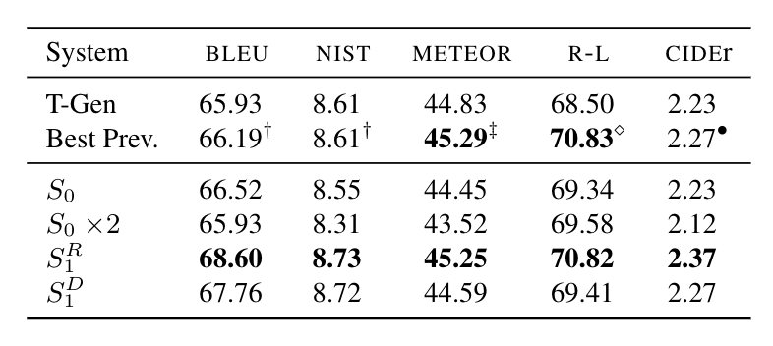
E2E Generation

Slide 59
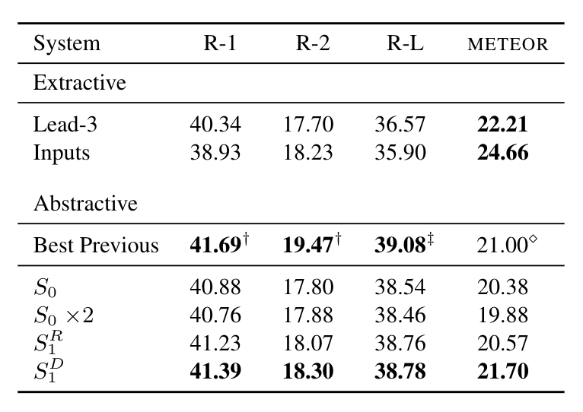
Abstract Summarization

Slide 60
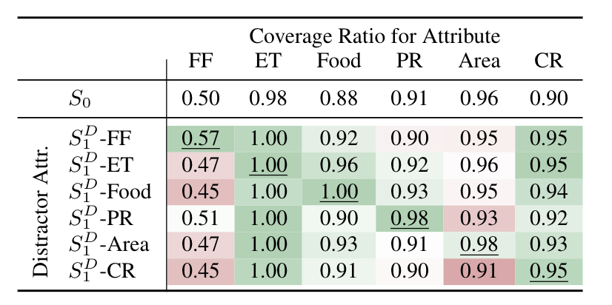
Coverage Ratio

Slide 61
Content Dropping
Human-written :
A cheap coffee shop is Fitzbillies. Fitzbillies serves English food.
Input meaning representation:
Name [Fitzbillies], Eat Type [Coffee Shop],
Food [English], Price Range [Cheap].
Base Seq2Seq Model:
Fitzbillies is a cheap coffee shop.
Notes:
Let’s start with a general generation case (specifically from meaning representation). The task is to describe the restaurant with attribute-key values from the input MR. However, we can see from the output of the base seq2seq model.
Convey (there is very common issues) => even though this is the output form the sota model, it fails to xxx. [English got dropped in the MR]
This leads us to a problem. How should this happen and can we simply resolve this?
Added riverside here because otherwise it’s hallucinating, but would be better to just simplify the MR?

Slide 62
Content Dropping
Output
Fitzbillies is a cheap coffee shop.
0.4
0.3
Input
Speaker
Output
Fitzbillies is a cheap English coffee shop.
Name [Fitzbillies], Eat Type [Coffee Shop],
Food [English],
Price Range [Cheap].
P(Output | Input)
0.1
Output
Fitzbillies is a coffee shop that serves English food.
…
Notes:
Let us step a little more into model side. At this point, we denote the base seq2seq model as the speaker. Given input, the speaker needs to model the conditional probability of generating the outputs.
In this case, the speaker actually has different output alternatives to choose from. The bold scores will be the normlized forward probability that the speaker assign to each alternative. However, it is straightforward for us to select the second output but it’s not for the speaker.
It means that maybe the forward probability is not informative enough for the speaker to advoid the content dropping issue.
we will get the first .
We will call this model as a speaker model (it will generate the output texts based on input) [greedy decoding, these outputs are all alternatives ] => do enough search such as beam search <= general way to select the most informative one to avoid the content dropping issue.

Slide 63
Pragmatics Model
Speaker
P(Output | Input)
Input
Output
Fitzbillies is a cheap coffee shop.
Name [Fitzbillies], Eat Type [Coffee Shop],
Food [English],
Price Range [Cheap].
✗
Listener
P(Input | Output)
Notes:
So how about we assit the speaker with a separate model which makes the information low complete and round-tripped.
Thinking about a listener, which models the backforward probability say given this output how likely it could identify the input.
In this way, the listener could hardly identify the English food attribute given the ioutput.Wwth dropping content.

Slide 64
Pragmatics Model
Speaker
P(Output | Input)
Input
Output
Fitzbillies is a cheap English coffee shop.
Name [Fitzbillies], Eat Type [Coffee Shop],
Food [English],
Price Range [Cheap].
Listener
✔
P(Input | Output)
Notes:
But with a complete output, the Listener successfully identify it!
Now we use the listener model to evaluate (English is present now).

Slide 65
How to get P_{listener}?
(S^{R}) Train a separate model (reconstructor-based).
(S^{D}) Use Bayesian inference over alternatives (distractor-based).
Notes:
The next step will be how should we model the listener that it could help us to differentiate the input.
We propose two different ways to do so. (One is reconstructor-based where we train a separate model, the other is distractor-based where we use the bayeian inference over alternatives.)

Slide 66
(S^{R}) Reconstructor-Based Pragmatics
0.4
Speaker
Output
Fitzbillies is a cheap coffee shop.
Input
x
Output
Name [Fitzbillies], Eat Type [Coffee Shop],
Food [English], Price Range [Cheap].
Fitzbillies is a cheap English coffee shop.
…
…
Listener
Notes:
Let’s start with the reconstructor-based approach.
At the first stage, the speaker assigns the according score for the corresponding output.

Slide 67
(S^{R}) Reconstructor-Based Pragmatics
0.4
Speaker
Output
0.08
Fitzbillies is a cheap coffee shop.
Input
x
Output
Name [Fitzbillies], Eat Type [Coffee Shop],
Food [English], Price Range [Cheap].
Fitzbillies is a cheap English coffee shop.
…
…
0.2
Listener
Notes:
We also scored it with the listener (what are these scores and how they combined.)
We need to create a listener for [black box can score given the input.] => these details should come latter.

Slide 68
(S^{R}) Reconstructor-Based Pragmatics
Speaker
Output
0.08
0.3
Fitzbillies is a cheap coffee shop.
Input
x
Output
0.18
Name [Fitzbillies], Eat Type [Coffee Shop],
Food [English], Price Range [Cheap].
Fitzbillies is a cheap English coffee shop.
…
…
Listener

Slide 69
(S^{R}) Reconstructor-Based Pragmatics
Speaker
Output
0.08
0.3
Fitzbillies is a cheap coffee shop.
Input
x
Output
0.18
Name [Fitzbillies], Eat Type [Coffee Shop],
Food [English], Price Range [Cheap].
Fitzbillies is a cheap English coffee shop.
…
…
0.6
Listener

Slide 70
(S^{D}) Distractor-Based Pragmatics
Input
✔
Output
Name [Fitzbillies],
Eat Type [Coffee Shop],
Food [English], Price Range [Cheap].
Fitzbillies is a cheap coffee shop.
Speaker
✔
Output
Distractor
Name [Fitzbillies],
Eat Type [Coffee Shop], Price Range [Cheap]
Fitzbillies is a cheap English coffee shop.
Notes:
Reconstuctor-based model
=> Effecively way to con [different output can be plugged in for the speaker.] [false to cause the distractors.]
(which one is the best explanation for each output.)

Slide 71
(S^{D}) Distractor-Based Pragmatics
Input
✔
Output
Name [Fitzbillies],
Eat Type [Coffee Shop],
Food [English], Price Range [Cheap].
Fitzbillies is a cheap coffee shop.
Speaker
✗
Output
Distractor
Name [Fitzbillies],
Eat Type [Coffee Shop], Price Range [Cheap]
Fitzbillies is a cheap English coffee shop.
Notes:
# distractor example has changed

Slide 72
(S^{D}) Distractor-Based Pragmatics
Normalization over inputs: choose a single distractor, in a domain-appropriate way.
Normalization over outputs: make word-by-word decisions.
Notes:
Normalization here is good!
Coffee+shop bigram issues. I still think we should do entire utterances, present word-level (and priors) as implementation details.
Distractor’s changed.

